Slide 1
Underground Natural Gas Storage: ensuring a secure and flexible gas supply
Jean-Marc Leroy
GSE President
Gas Coordination Group - 13 January 2010

Slide 2
Agenda
Natural Gas Storage: what does it mean?
Dynamics of Natural Gas Storage
Operation of Natural Gas Storage: constraints management
IV. Conclusion

Slide 3
I. Natural Gas Storage: what does it mean?

Slide 4
Storage technologies
• Storage types
  porous rock storage: aquifer / depleted field
  salt cavern storage
  leaching facilities (during creation)
  gas facilities (during operation)
• Surface facilities
  compressors
  gas treatment

Slide 5
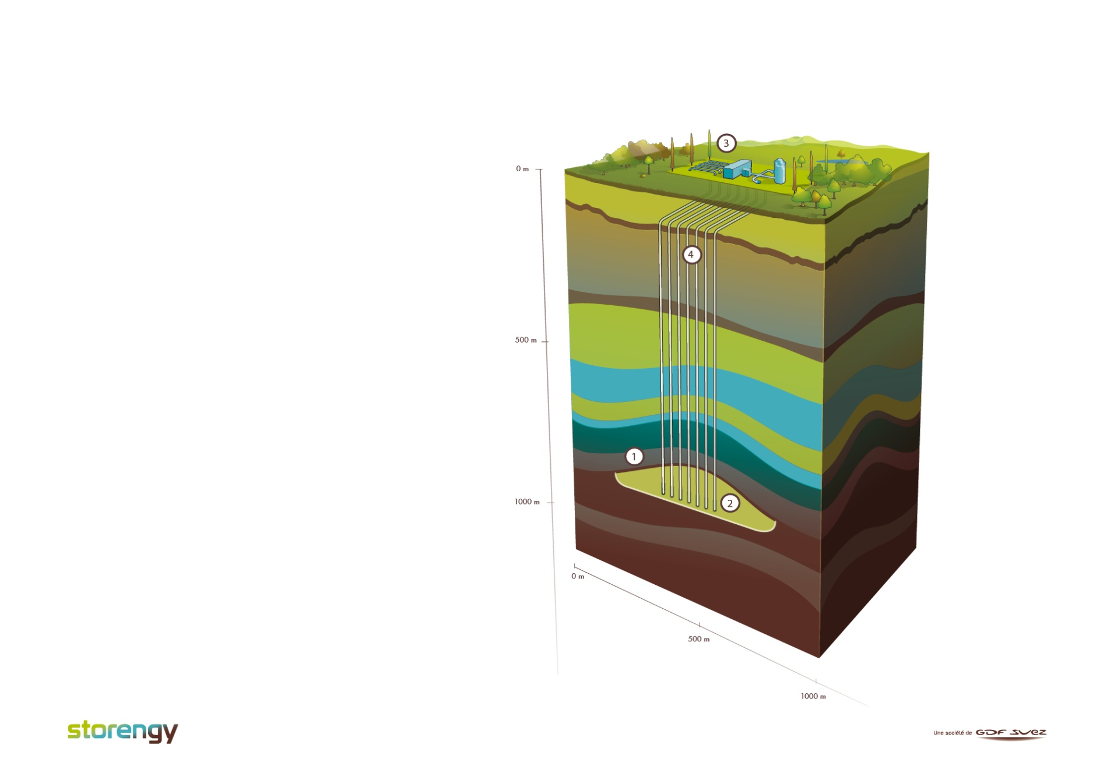
Porous rock storage : depleted field
Created in a depleted oil or gas field.
Gas is re-injected into a porous rock formation -> like a sponge absorbing water.
Gas is kept in place thanks to impermeable cap rock.
Geological properties determine the characteristics of the reservoir:
Porosity - determines the capacity of the rock to hold gas.
Permeability - determines the ability of the rock to transmit gas.
1
Covering layer
Reservoir
Central station
Production well
2
3
4

Slide 6
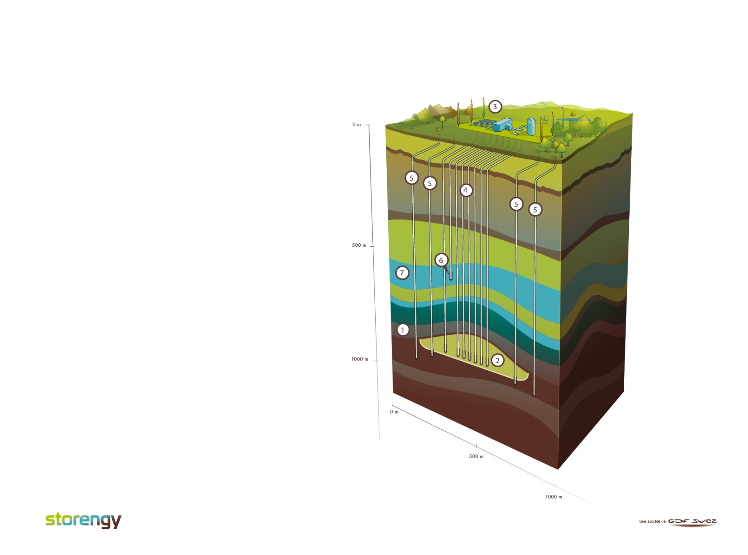
Porous rock storage : aquifer
Located in geological formations similar to those of depleted fields (porosity, permeability).
Unlike in depleted fields, pores are filled with water.
In injection, water is pushed down the formation.
In withdrawal, the reverse happens.
Operation is more complex -> gas may migrate into the water-bearing strata.
Upon extraction, gas requires further dehydratation.
1
Covering layer
Reservoir
Central station
Production well
Verification well
Verification well of the upper aquifer
Upper aquifer
2
3
4
5
6
7

Slide 7
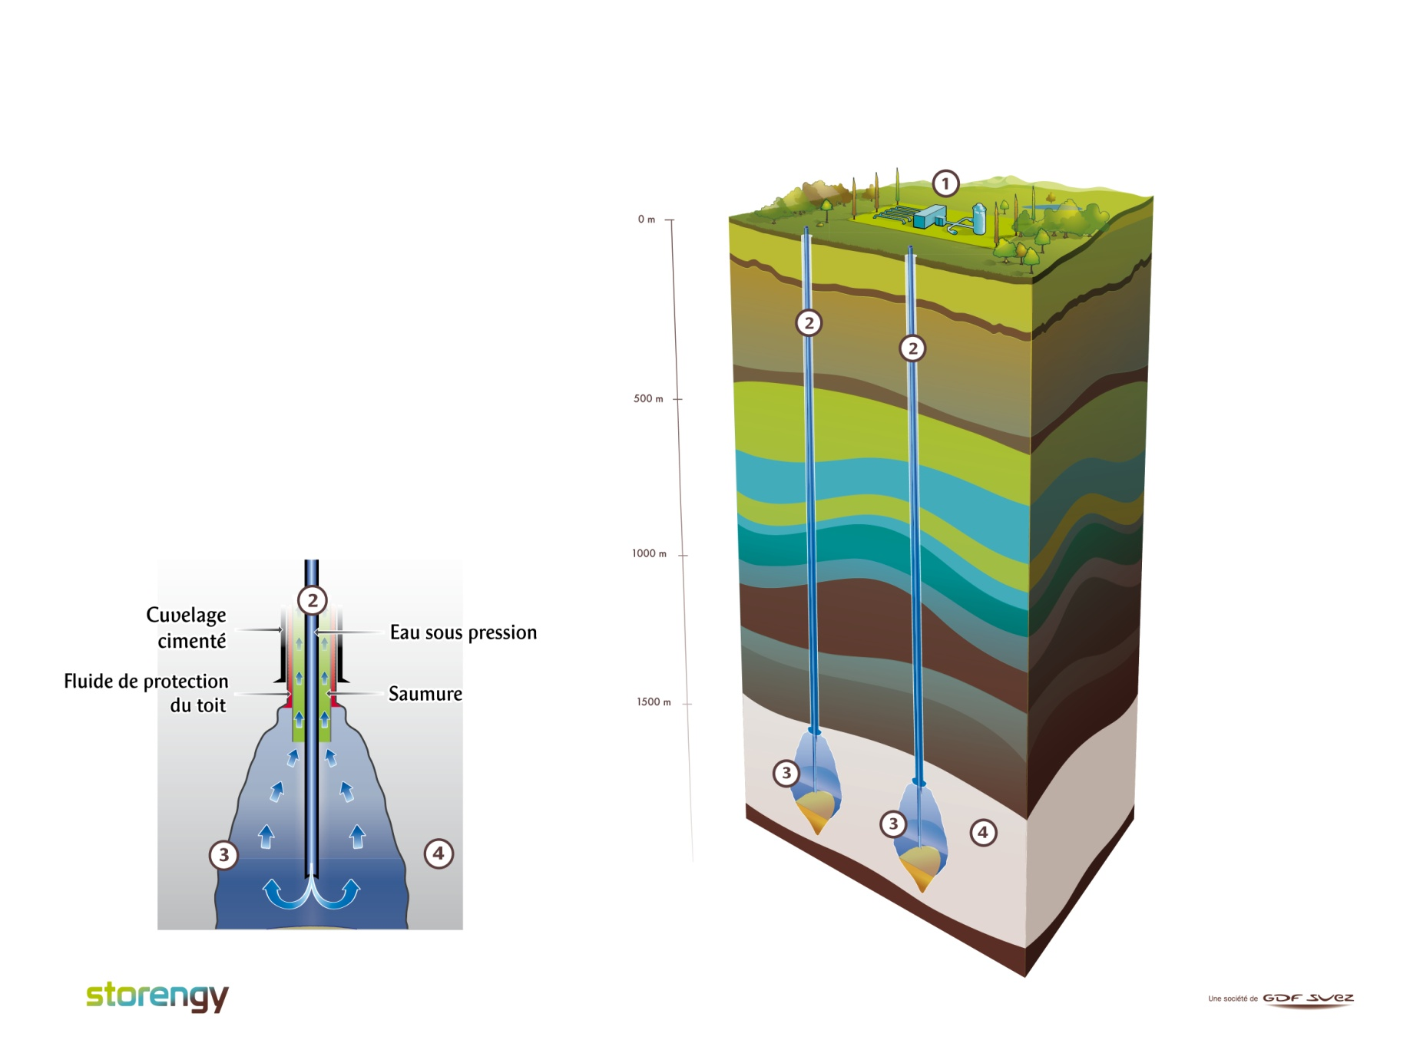
Salt cavity storage
Formed out of salt deposits by dissolving and extracting salt (leaching).
Resilient and watertight -> reduced gas migration.
Salt properties determine, inter alia:
  cavern diameter and height
  max and min operating pressure.
1
Central station
Production well
Salt caverns
Layers of rock salt
2
3
4

Slide 8
Different types of storage:
different characteristics and use
The characteristics of gas storage differ depending on the geological properties of the reservoir which in turn define their use.
 | Depleted Field | Aquifer | Salt Cavity
Working Gas Volume | High | High | Relatively low
Withdrawal Rate* | Low | Low | High
Injection Rate* | Low | Low | High
*as compared to Working Gas Volume
Depending on the type of storage, a different share of residual (cushion) gas needs to be maintained to ensure appropriate reservoir pressurization necessary for appropriate injection and withdrawal rates.
 | Depleted Field | Aquifer | Salt Cavity
Cushion gas | ~50% | ~80% | ~30%

Slide 9
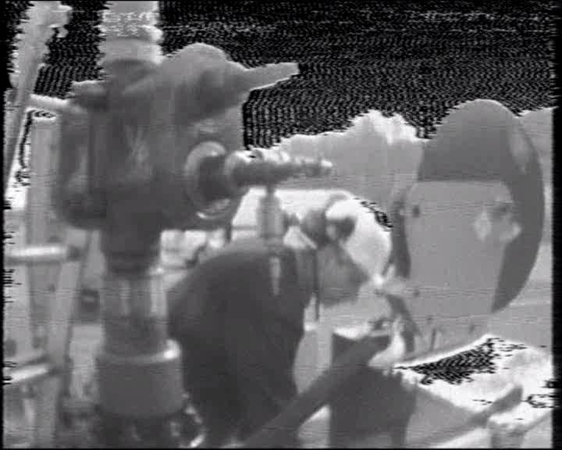
A Journey to the Center of the Earth
(Jules Verne, 1864)
Source: Storengy

Slide 10
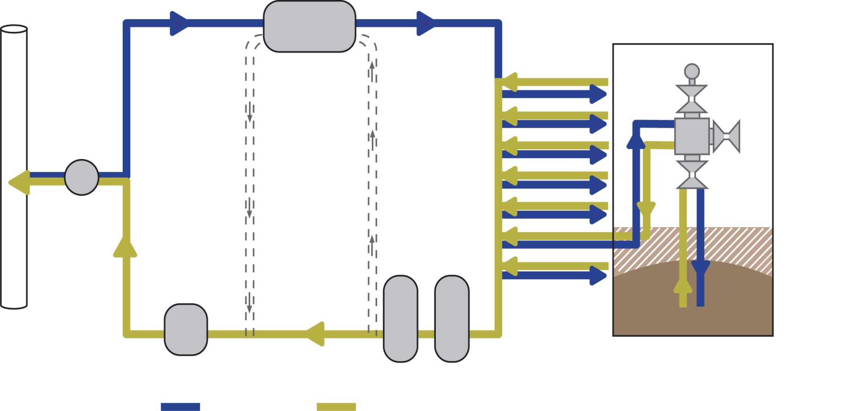
Surface facilities: schema
Compression
Gas headed to or coming from the well
Well
During injection or withdrawal if necessary
Counting
Odorisation
Dehydration
Desulphurisation if necessary
Central station
INJECTION
withdrawal

Slide 11
Compressor units
Currently, three main types of compressor units, with different characteristics, may used at storage sites:
 | Flexibility | Reliability | Power output | Environmental friendliness
Motor-driven compressor |  |  |  | ‒
Turbine-driven compressor |  |  |  | 
Electric compressor |  |  |  | 

Slide 12
II. Dynamics of Natural Gas Storage

Slide 13
What do we mean when we say…
  is the volume of gas that can be extracted during an operation of a facility (available to the marketplace)
  is not constant but depends on the operation cycles of storage
  rate (per time unit) at which gas can be rate (per time unit) at which gas can withdrawn from storage be injected into storage
  deliverability and injectability rates are variable and depend on a range of factors:
        type of storage (pore storage vs. salt cavity)
        geological properties of the given facility
        amount of gas in the reservoir (inventory level)
        pressure within the reservoir
        dimension of production wells
        capacity of surface facilities
        ….
Working Gas Volume
Deliverability
Injectability

Slide 14
Examples of injection and withdrawal curves : aquifer
Injection
Withdrawal
Injection rate
Withdrawal rate
Stock level
Stock level

Slide 15
Examples of injection and withdrawal curves : salt cavity
Injection
Withdrawal
Injection rate
Withdrawal rate
Stock level
Stock level

Slide 16
III. Natural Gas Storage: constraints management

Slide 17
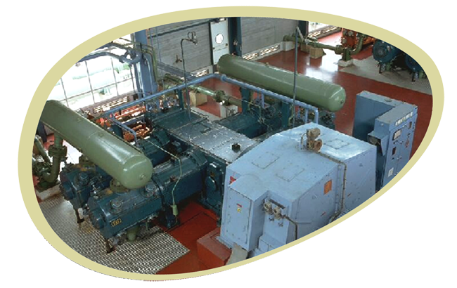
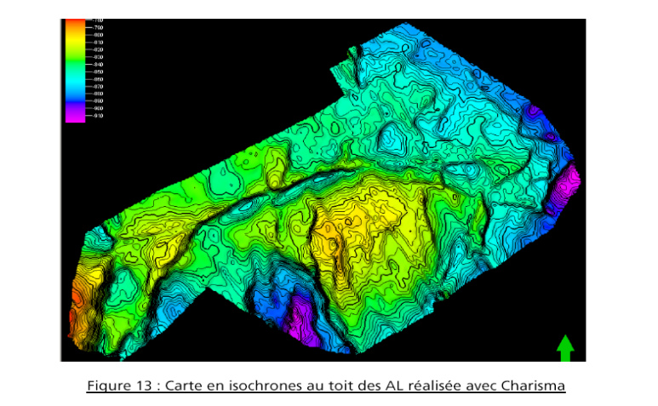
Surface facilities
Subsurface
constraints
management
Market demand
Seasonal use
Balancing
Weekly flexibility
Intra-day flexibility
Arbitrage

Slide 18
  When offering storage services, Storage System Operators are faced with a number of operational challenges and risks to control….
  Salt cavern creep
    occurs if the minimum operating pressure
    is reduced too far
    is due to salt properties
    leads to deformation and
    cavern closure =
    loss of working volume
Sonar 2007
-1400
-1410
-1420
-1430
-1440
-1450
-1460
-1470
-1480
-1490
Sonar 1980
Sonar 1970
-40 -30 -20 -10 0 10 20 30 40

Slide 19
  Sand production in aquifer
    due to pressure variation cycles and deterioration of safety components (valves)
    decreases well productivity
    Viscous fingering in aquifer
    may occur in the injection phase and affects diffusion of gas
    caused by flow instability (interface gas –water)
    gas forms “fingers” extending into water (gas trapping)
    leads to loss of working volume

Slide 20
Viscous fingering phenomenon
Appropriate injection rate
Too rapid injection rate
Source: Storengy
Notes:
Expertise pour la préservation, c’est aussi limiter certains vitesse d’injection, car on peut endommager le réservoir

Slide 21
IV. Conclusion

Slide 22
A number of physical and technical factors determine the dynamics of storage.
These different challenges are successfully managed on daily basis by Storage System Operators to respond to
    market needs
    security of supply challenges.
Experience has shown that storage facilities deliver very well, be it in “business-as-usual” as well as in stress situations.

Slide 23
Thank you for your attention

Slide 24
Aquifer storage : injection
peripheral
shut-in well
peripheral
shut-in well
Inj/withdraw well
stop well
upper aquifer
monitoring
well
central
station
from the
transmission
network
pipeline
network
closure
Notes:
Aquifer storage

Slide 25
Aquifer storage : withdrawal
Opening of the wells
central processing
station
to the transmission
network
pipeline
network
Notes:
Aquifer storage

